Slide 1
31ème Communauté Presbytérienne au Congo

Slide 2
Presentation
Brief Overview
Church Organization
Statistics and Challenges
Project Successes
Conclusion

Slide 3
First Church Built by the Presbyterian Church of the Congo in LUEBO in 1891

Slide 4
Democratic Republic of the Congo Has Nine Bordering Countries

Slide 5
Provinces Served by the CPC
Kasaï
Kasaï Central
Kasaï East
Lomami
Haut- Katanga
Kinshasa
Bandundu

Slide 6
FACTS ABOUT THE PRESBYTERIAN CHURCH OF THE CONGO
- 126 years old
1,002 churches
95 presbyteries
12 synods
3,470,000 members

Slide 7
MISSION STATEMENT OF THE CPC
The main mission of the CPC is Evangelization according to the order given by the Lord Jesus Christ through education, medical services, community and social development ministries in harmony with the Gospel of Christ.

Slide 8
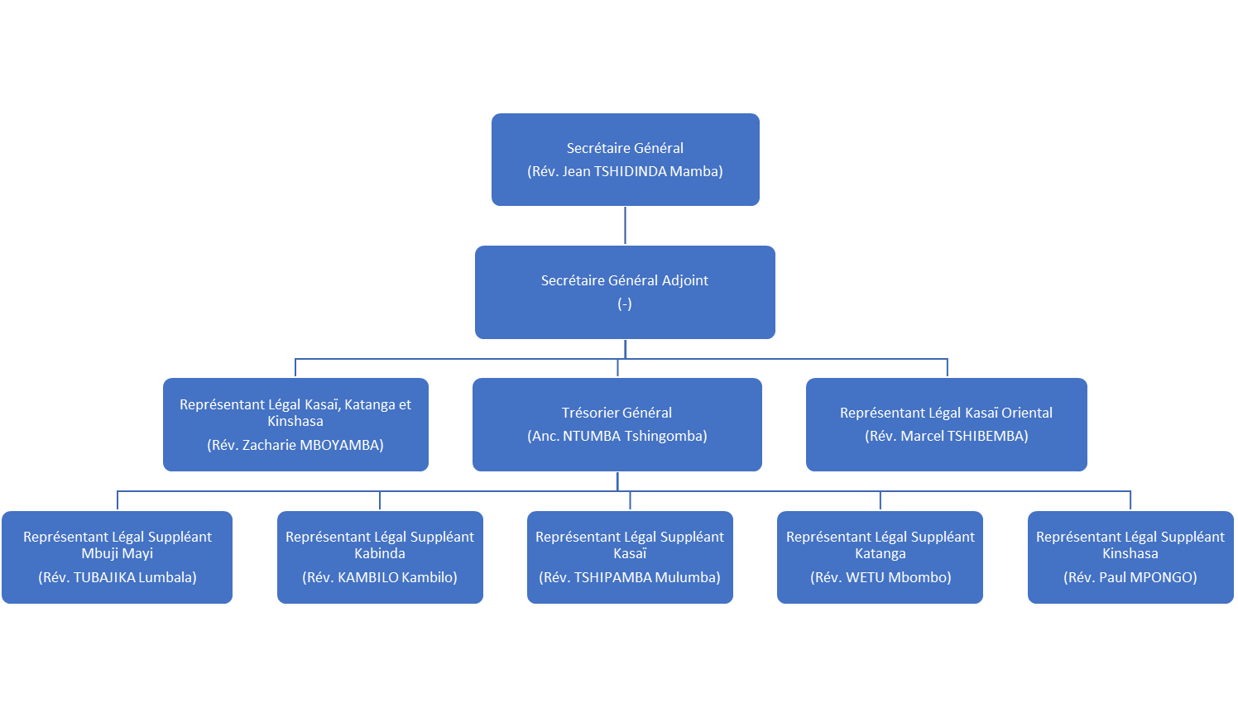
ADMINISTRATION OF THE CPC

Slide 9
CHURCH DEPARTMENTS
Evangelism and Church Life
Medical Services
Education
Women and Family
Community Development
Property and Equipment

Slide 10
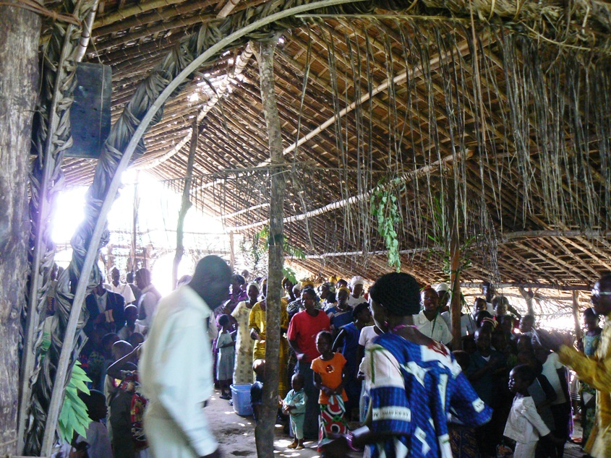
DEPARTMENT OF EVANGELISM

Slide 11
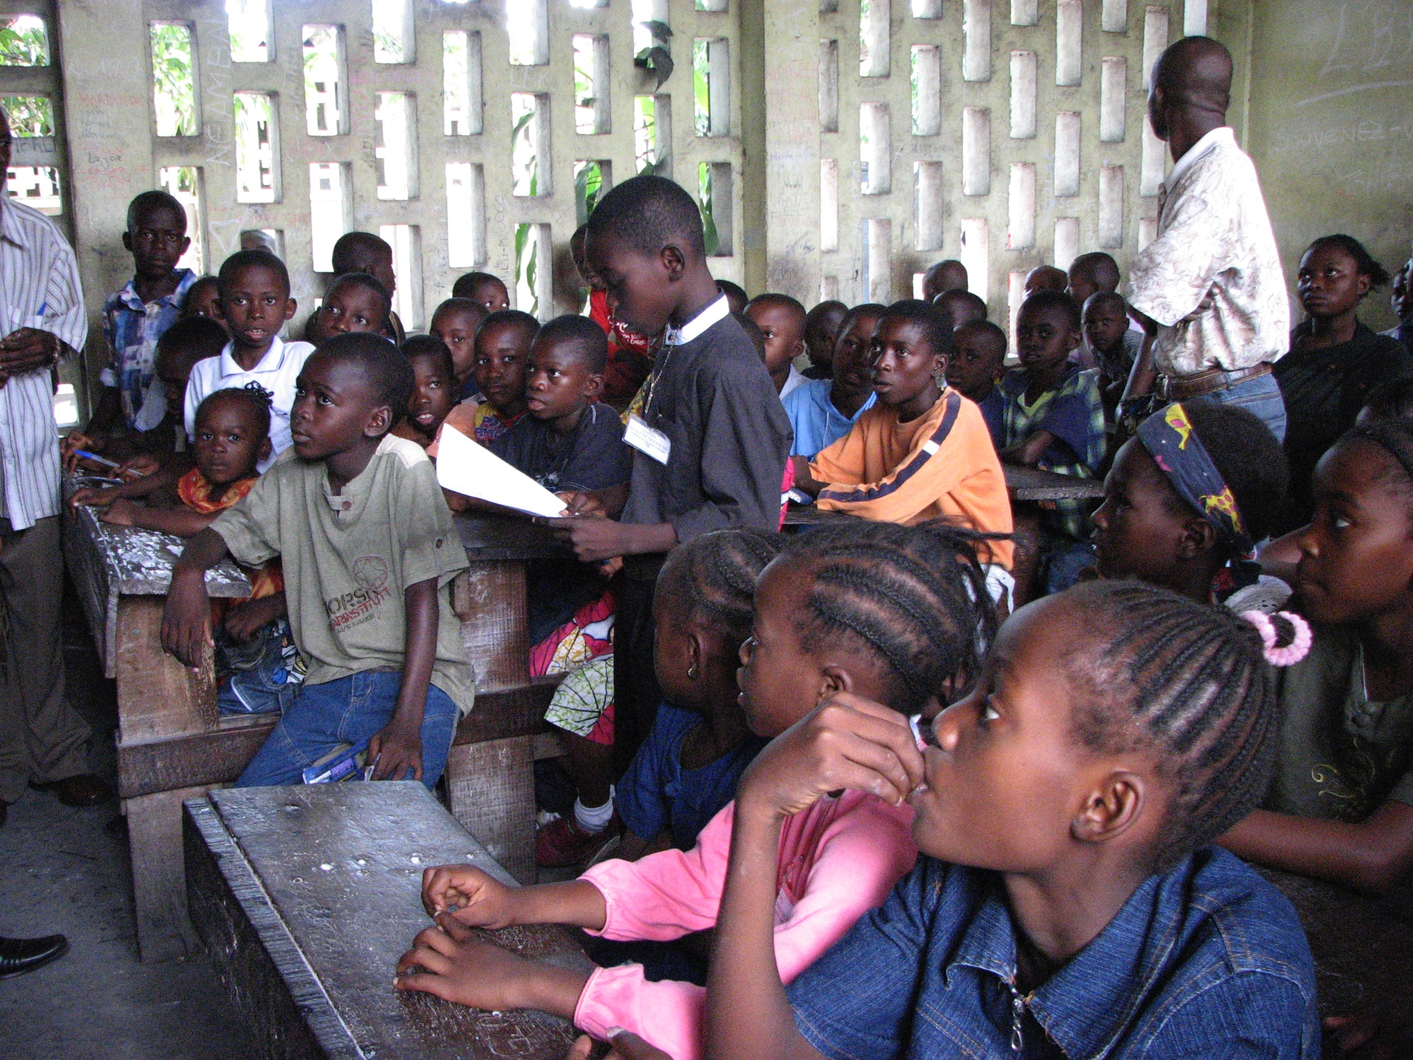
CHRISTIAN EDUCATION
DEPARTMENT OF EVANGELISM

Slide 12
MUSIC MINISTRY
DEPARTMENT OF EVANGELISM

Slide 13
Trauma Healing Ministry
Children hearing trauma healing story
Teens place their personal stories at the foot of the cross

Slide 14
Vulnerable Children’s Ministry
Host Family
Children waiting to be fed

Slide 15
RADIO STATION
DEPARTMENT OF EVANGELISM

Slide 16
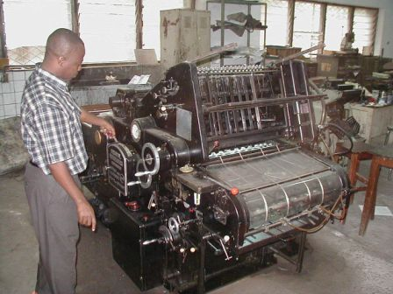
Printing Services for Churches and Schools
DEPARTMENT OF EVANGELISM

Slide 17
PASTORAL INSTITUTE AND SEMINARY - UPRECO
DEPARTMENT OF EVANGELISM

Slide 18
Protestant Center for Meetings and Guest Housing
DEPARTMENT OF EVANGELISM

Slide 19
New Church Construction
DEPARTMENT OF EVANGELISM

Slide 20
MEDICAL MINISTRIES
11 Hospitals (Bulape, Luebo, Lubondaie, Moma, Mutoto, Bon Berger Tshikaji, Dibindi, Bibanga, Kabuabua et Mboie) with 21 doctors, 532 staff, 797 beds. 5 Medical Training Centers (Bulape, Lubondaie, Mutoto, Tshikaji et Bibanga) 1 Medical University (IMCK-Tshikaji) : Good Shepherd Hospital

Slide 21
MEDICAL MINISTRIES: LUEBO HOSPITAL

Slide 22
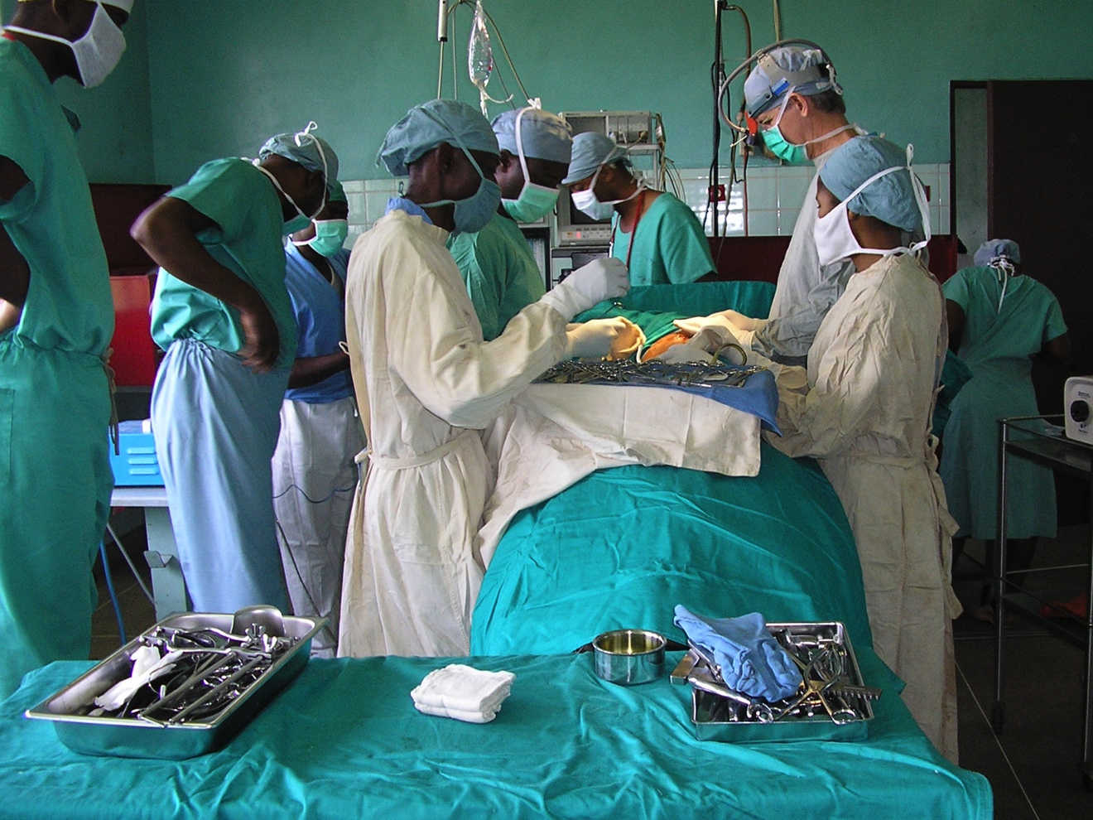
IMCK - MEDICAL TRAINING CENTER AND HOSPITAL
MEDICAL MINISTRIES

Slide 23
MEDICAL TRAINING

Slide 24
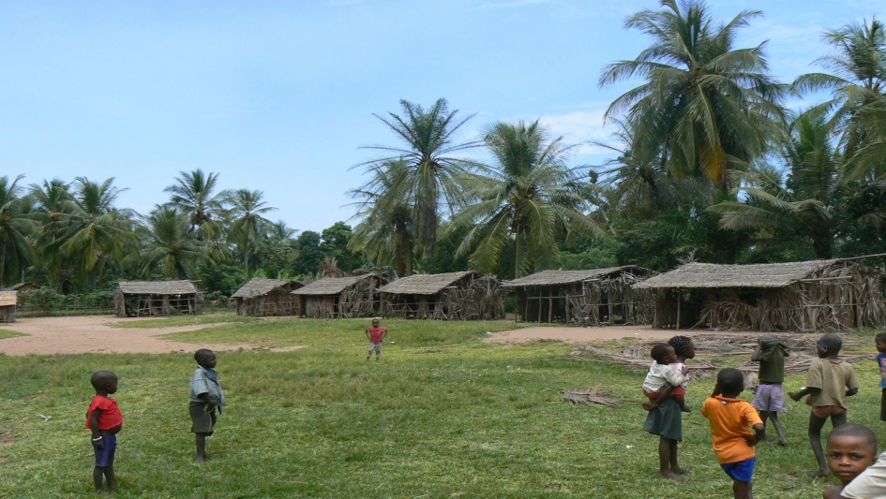
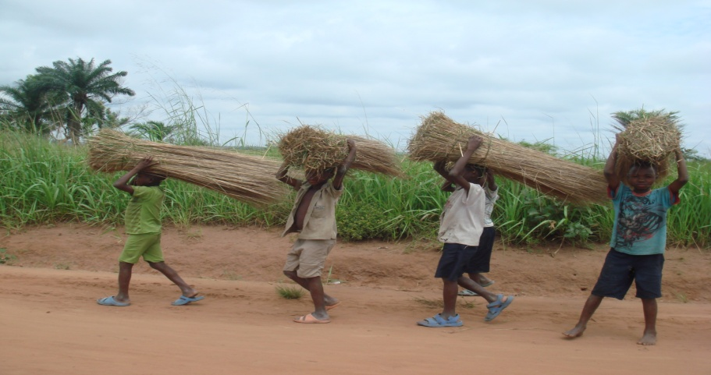
EDUCATION DEPARTMENT
- 558 Primary schools, educating 170K students (48% girls)
310 Secondary schools, educating 43K students (35% girls)
78% of these schools are made of non-durable materials
7000 teachers, of whom about 14% are women
1 University (UPRECO) for law, theology, IT, agriculture

Slide 25
CONSTRUCTION OF ZAPO ZAPO SCHOOL IN 2013
EDUCATION DEPARTMENT
Before
After

Slide 26
CONSTRUCTION OF DIPA DIA NZAMBI GIRLS’ SCHOOL IN 2015
EDUCATION DEPARTMENT

Slide 27
GIRLS’ COMPUTER AND ENGLISH PROBRAM NEEDS FINANCIAL SUPPORT NOW!!
EDUCATION DEPARTMENT

Slide 28
EDUCATION DEPARMENT
TEXTBOOKS PROVIDED TO TEACHERS

Slide 29
TEACHER TRAINING
EDUCATION DEPARTMENT

Slide 30
EDUCATION DEPARTMENT
BENCHES PROVIDED

Slide 31
WOMEN IN PRESBYTERIAN UNIVERSITIES ARE SUCCEEDING
EDUCATION DEPARTMENT
Law School
Seminary

Slide 32
Women’s and Family Department
DEPARTMENT OF WOMEN AND FAMILIES

Slide 33
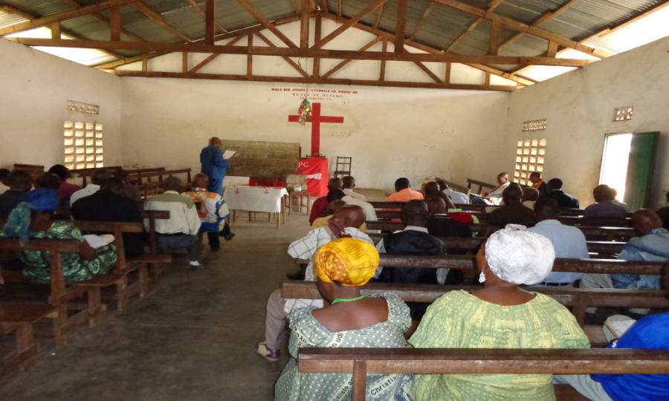
SEMINAR ON FINANCIAL LITERACY

Slide 34
WOMEN WALK TOGETHER FOR SAFETY AND WATER INCOME

Slide 35
COMMUNITY DEVELOPMENT DEPARTMENT
AGRICULTURAL IMPROVEMENTS PROVIDE FOOD AND INCOME

Slide 36
MANAGEMENT OF WATER RESOURCES

Slide 37
PINEAPPLE PRODUCTION FOR FOOD AND INCOME

Slide 38
WOMEN PRODUCE PALM NUTS FOR COOKING OIL AND SOAP

Slide 39
PIG FARMING FOR FOOD AND INCOME

Slide 40
UNFUNDED GOALS OF THE CPC
WOMEN AND FAMILY DEVELOPMENT
Construct wells and create a water distribution network in Kananga ($138K) to:
Improve quality of water and health
Reduce distance for women to fetch water (and improve their safety!)
Generate sale of potable water
Provide reliable potable water to the maternity clinic in Kananga!
Construction of a center dedicated to under-educated young mothers in Kananga, to provide them with spiritual, life and work skills (100K$)

Slide 41
UNFUNDED GOALS OF THE CPC
EVANGELISM
Purchase 10,000 Tshiluba language bibles ($90K) over 5 years
Support victims of violence, through pastoral visits to provide a bible
and material support ($15K)
COMMUNITY DEVELOPMENT
Launch sheep farming projects in the former Mission Stations, to
provide food and income in rural areas ($20K)
EDUCATION
3 school constructions
Text books, plus tools for vocational training
Teacher training in Ndemba
Motorcycles for school supervisors
Sustain High School Girls’ Computer and English Program

Slide 42
CONCLUSION
A great thank you to all our partners and we ask that God continues to bless you.
Everything you continue to do and provide will be welcome and put to God’s service.
We hope to maintain and enrich our relationship in the future

Slide 43
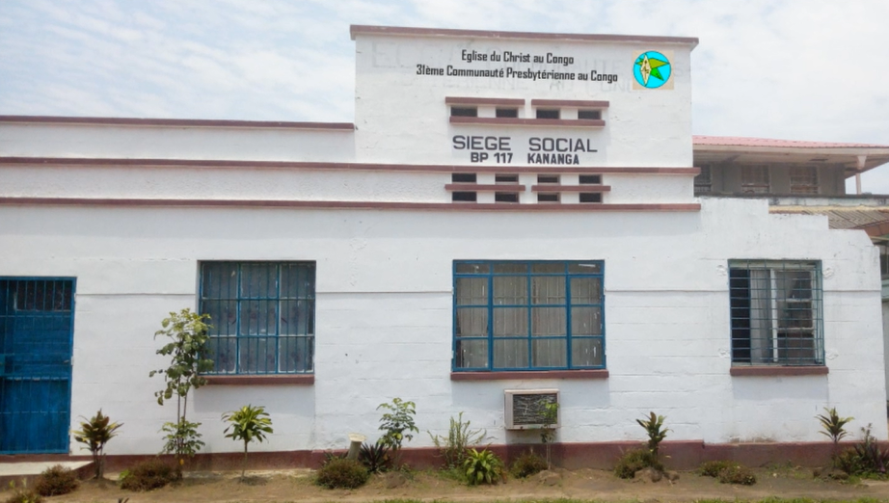
Tuasakidila
?Rév. Pasteur Jean TSHIDINDA Mamba

